Slide 1
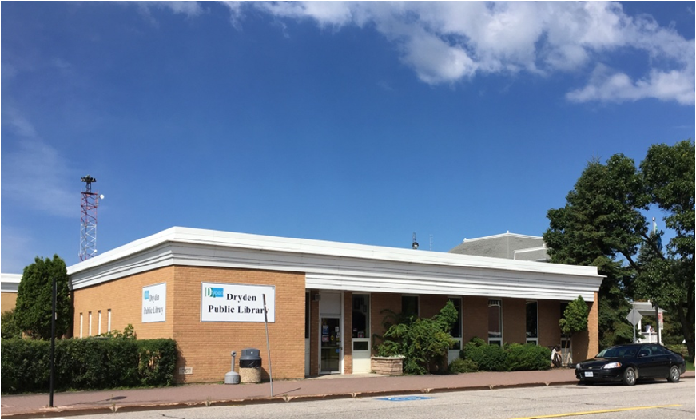
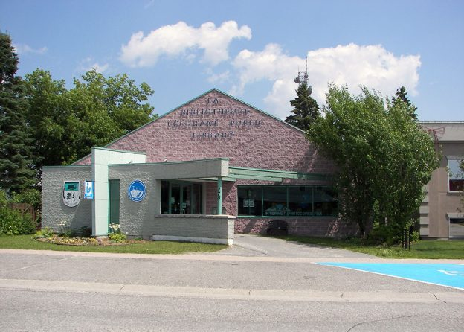
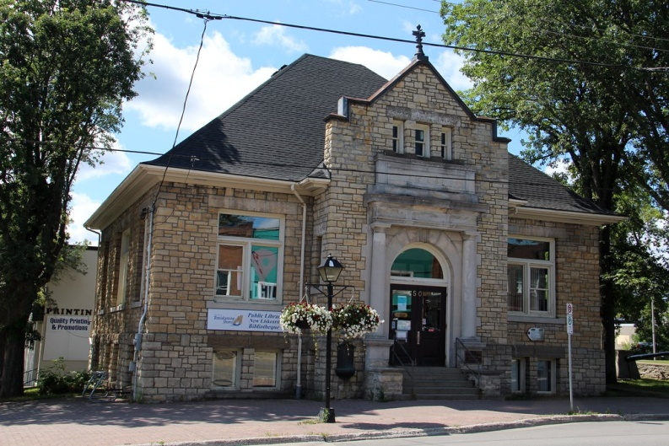
Small But Mighty
How Ontario’s Small Northern Libraries Contribute to the Provincial Library Landscape
Presented by:
Dayna DeBenedet | CEO, Dryden Public Library
Rebecca Hunt | CEO, City of Temiskaming Shores Public Library
Ardis Proulx-Chedore | Program Coordinator and Archivist, Cochrane Public Library

Slide 2
Dryden Public Library

Slide 3
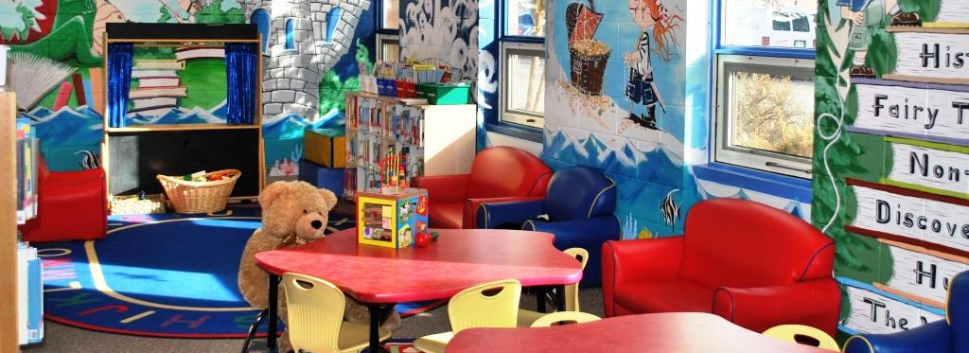
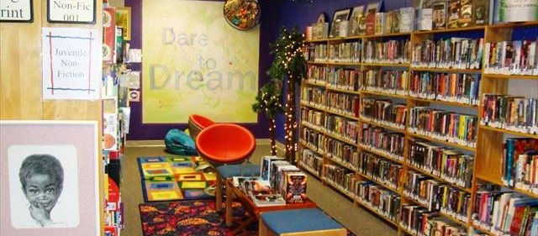
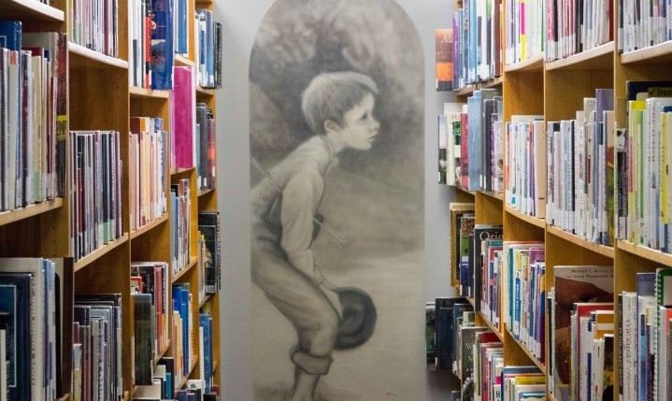
Developing a “Community Living Room”
At DPL we face considerable space challenges, both due to the size of our facility and the age/utility of our space.
We have fully committed to the concept of a community Living Room
Focus on comfort
Colour, Art and Murals
Embracing the quirks of our community and our space
Letting the space set the tone
Our patrons are so attached to the look and feel of the Library that protecting that feel is the most common feedback we get in public surveys.

Slide 4
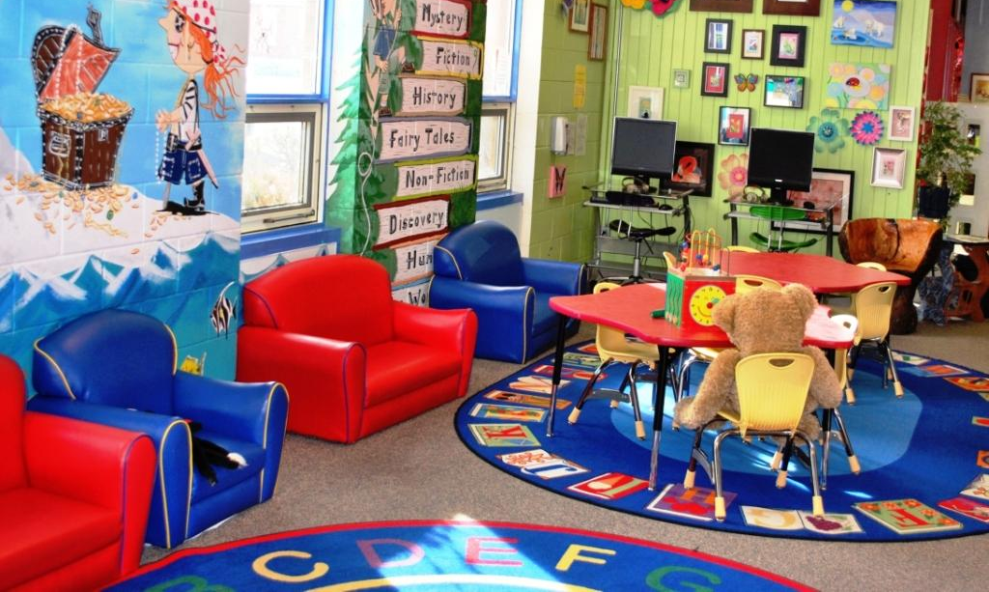
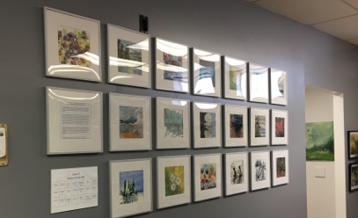
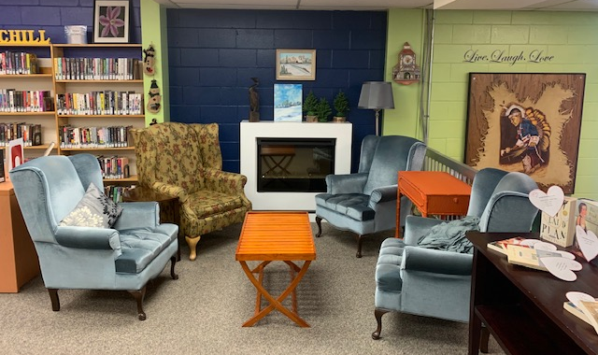
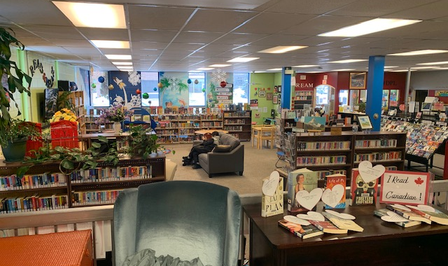
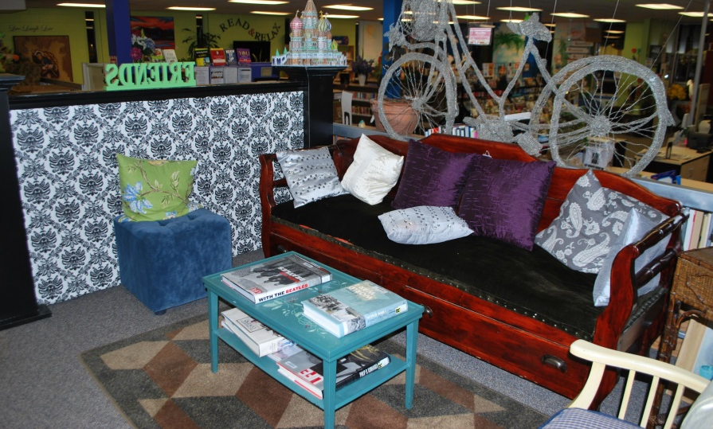
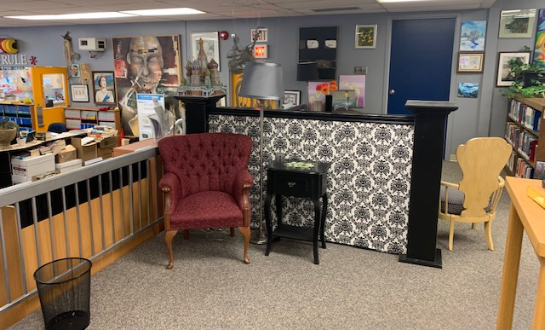
A Quirky Community Living Room
Children’s Section
Art Quilt Installation by the Dryden Artists Association
A mismatched seating area and fireplace
A view through the Library
“The Ghost Bike” by Michelle Goodman
A quiet reading corner.

Slide 5
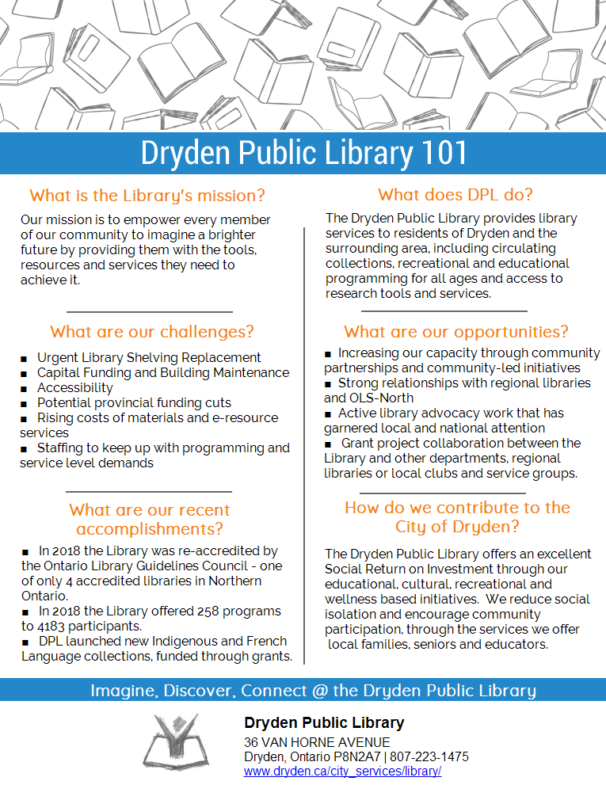
Advocating on the Local Level
After the 2018 Municipal election our Library Board began thinking more intentionally about board recruitment and council orientation. Some of the strategies we developed included:
Targeted Board Recruitment and Board Recruitment Tools
Legacy Document
Council Speed Dating
Locally Developed Council Orientation Material
Advocacy-focused communication

Slide 6
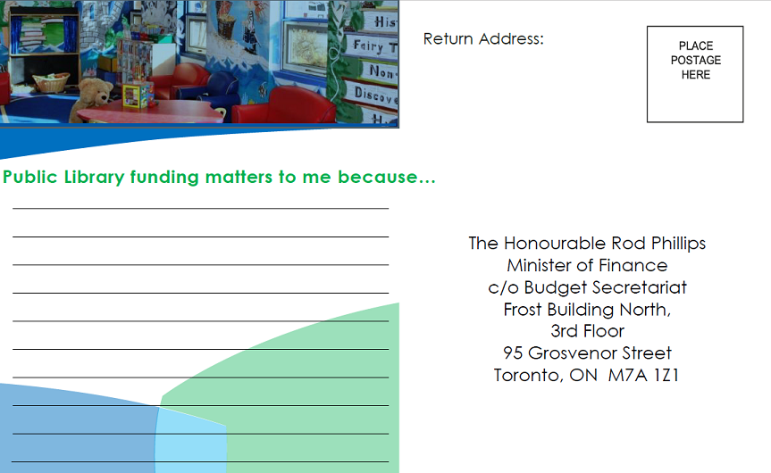
Advocating on a Regional/Provincial Level
Starting in the Spring of 2019 our Library got involved with larger scale advocacy on behalf of libraries in Northern Ontario.
Statement on behalf of 58 Libraries
Development of templates
SaveOLSN.ca
Media Engagement
Library Postcards
Northern outreach with OLA
Possible development of Northern Libraries Advocacy committee.

Slide 7
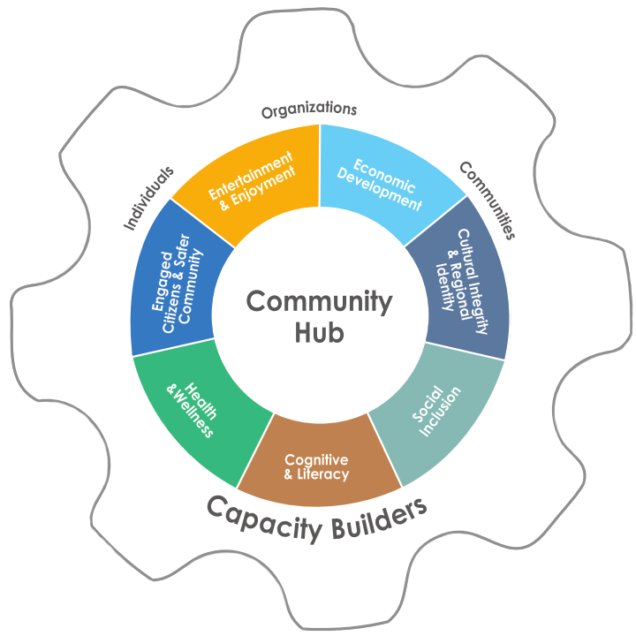
Valuing Northern Libraries Project
Initiated by the Temiskaming Shores Public Library, and supported by OLS-North a steering committee of six libraries was formed to apply for OLCF Grant Funding.
The Nordik Institute was hired to develop a toolkit that would allow Northern Ontario Libraries to measure their Social Return on Investment.
The toolkit measures impact in seven areas:
Cultural Integrity & Regional Identity
Social Inclusion
Cognitive & Literacy Development
Health & Wellness
Engaged Citizens & Safer Communities
Entertainment & Enjoyment
Economic Development
Notes:
Ontario Library Services North (OLS-North) applied to the Ontario Library Capacity Fund Research and Innovation Grant and was successful in funding to address the need to measure the impact of libraries in areas such as literacy, citizen engagement and health and well-being in order to illustrate the social and economic contribution of Northern libraries as community hubs

Slide 8
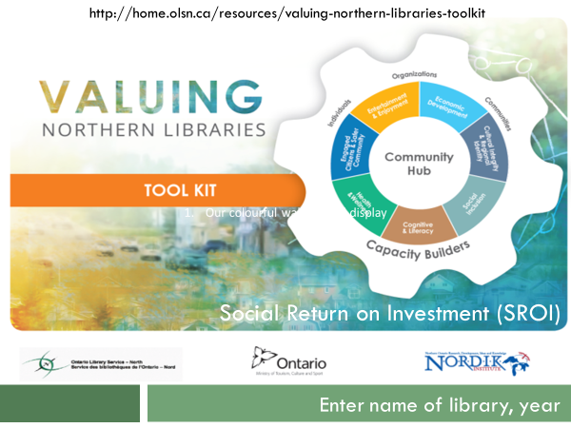
Using the Toolkit
Conduct a focus group to collect feedback from patrons and community stakeholders.
Write a community profile using the template provided online.
Gather your data from the Annual Survey of Public Libraries and ILS reports etc.
Use your data to complete the Excel template, which will calculate the SROI calculations for you.
Assemble your SROI report from the template provided and prepare a Powerpoint presentation using the slide templates available online.
Present your results to the Library Board, Council, media, community partners etc.
Use your results and data in infographic templates and on social media.

Slide 9
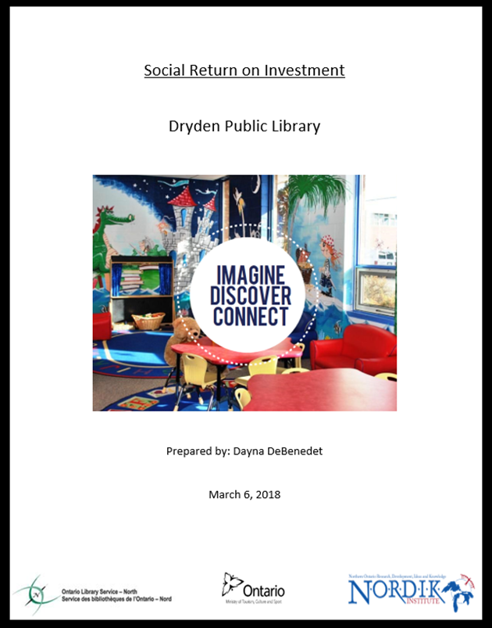
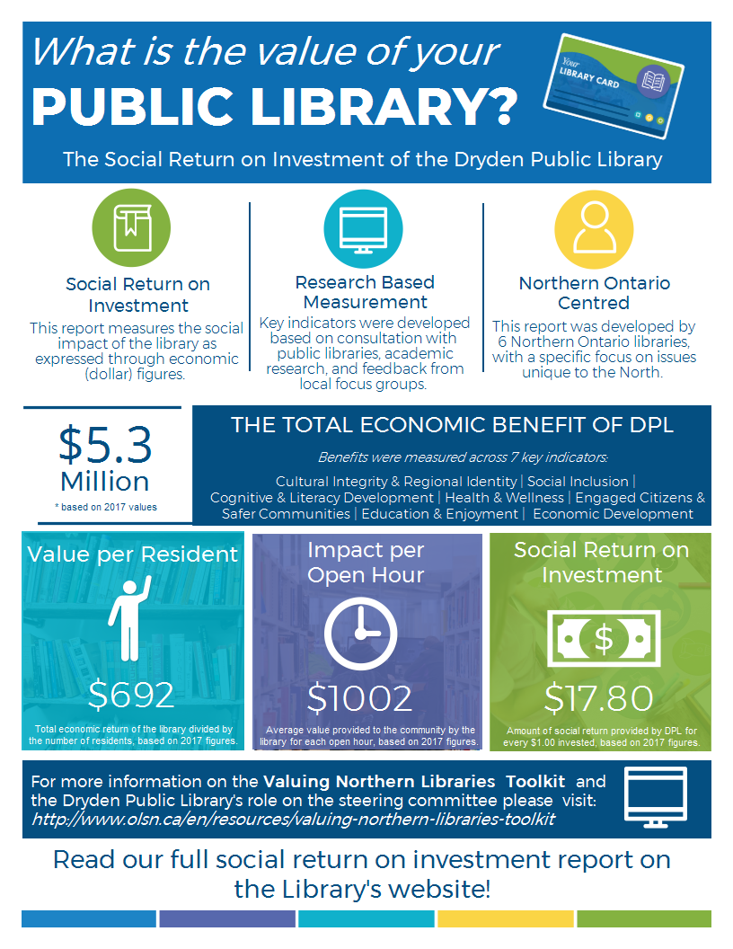
Valuing Northern Libraries Toolkit

Slide 10
Temiskaming Shores Public Library

Slide 11
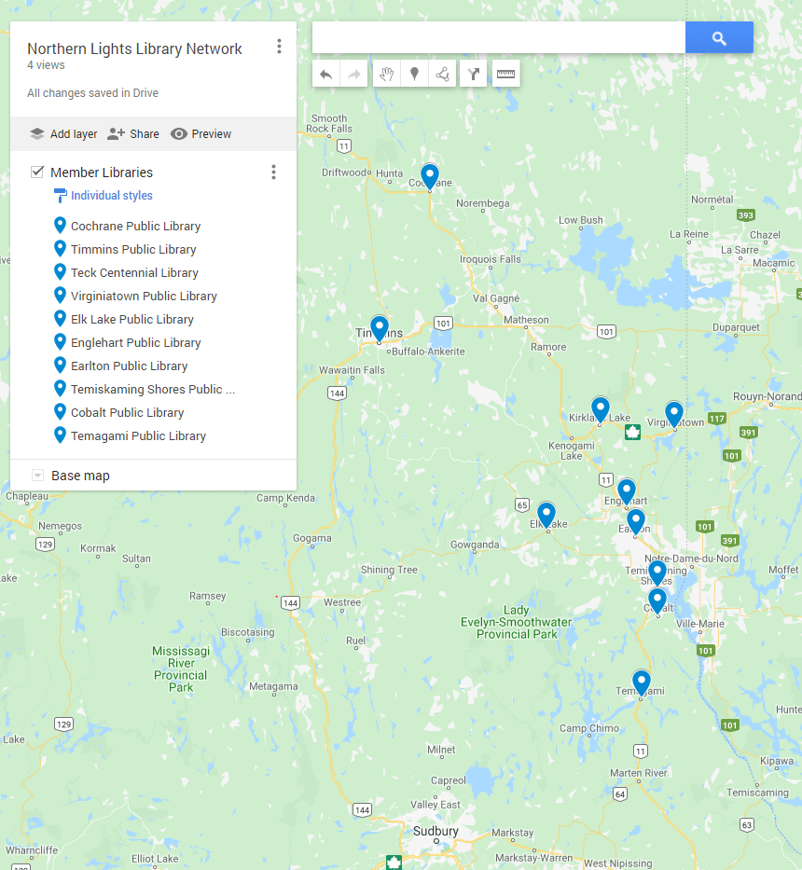
Northern Lights Library Network
Began in 2007
Meets 2-3 times a year
Successful in two grants for IT Support shared position
Face to face meetings help to facilitate connections over distances—more comfort
Share ideas, policies, procedures, partner on programming opportunities
Notes:
The Northern Lights Library Network first met in August 2007. The libraries along highway 11 wanted a venue to share ideas and partner on programs.
There are 10 member libraries, from Temagami at the southern part of the region to Cochrane at the Northern part.
The group partnered twice on projects to hire an IT Support person to share support services in the southern part of the region. They have also partnered to bring Ontario Early Years programming into the libraries and to host NEOnet seniors computer training programs.
There are some challenges to the network:
Timing: Difficult to find a good time to meet, especially for libraries with few staff
Distance: Travel time can be 2-3 hours for some libraries
Funding: Some library boards do not pay time and expenses to attend network meetings
At this time the group meets mostly to share information, policies and procedures and programming ideas.

Slide 12
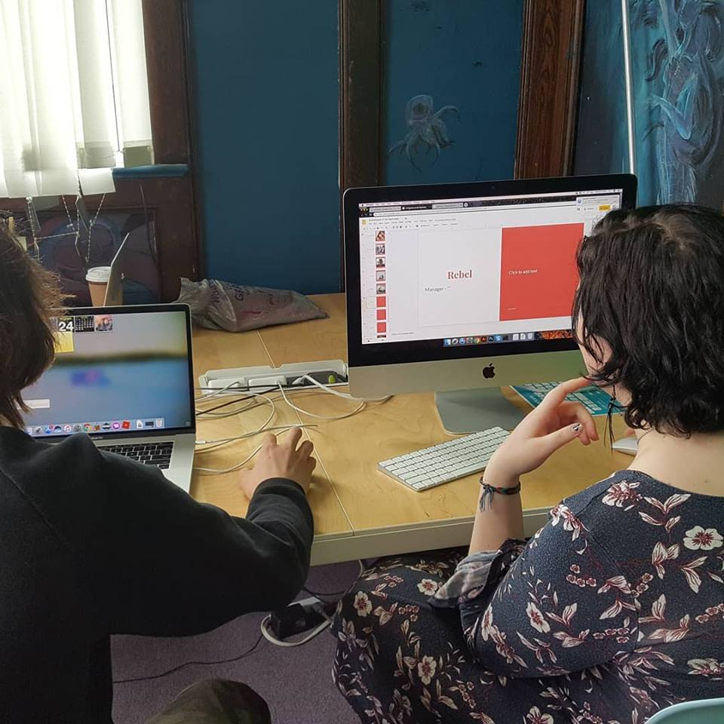
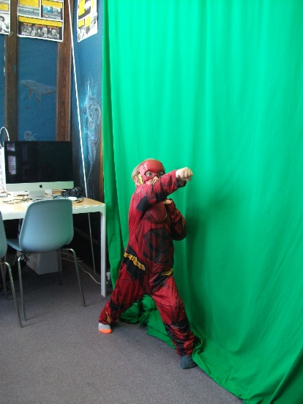
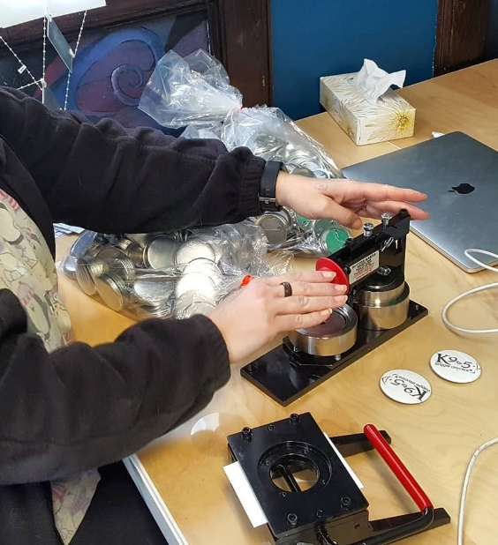
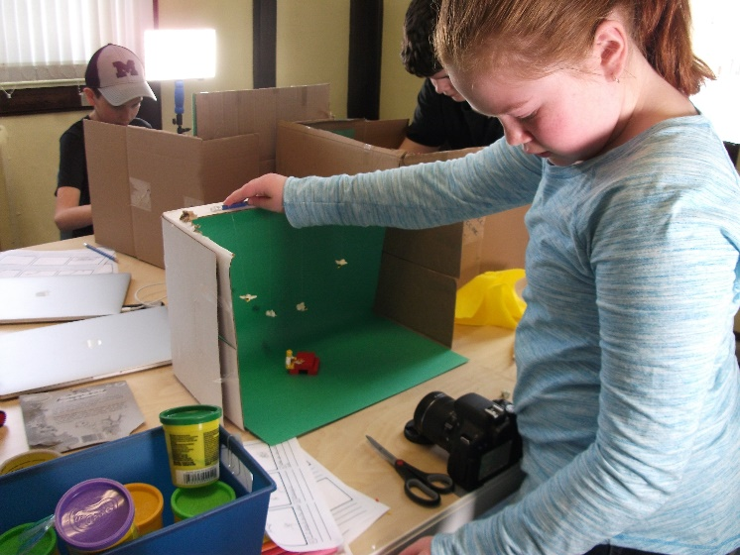
Digital Creator Partnership
Work on the partnership with the Near North Mobile Medial Lab began in 2016
Our first intern was hired with an NOHFC grant 2017-2018.
Focus is on teens but have recently started targeting tweens and adults for intro to 3D printing, photography and other workshops.
We have a 3D printer, green screen, button maker and photography, sound and filming equipment
In addition to regular workshops geared towards the different age categories, people are encouraged to stop in an try the out the equipment.
Notes:
Near North Mobile Media Lab approached the library in 2016 to see if we would be a site for a Digital Creator Lab. There are six locations across Northern Ontario
Hired an intern with an NOHFC grant 2017-2018, then with a Trillium grant.
Focus is on teens but have recently started targeting tweens and adults for intro to 3D printing, photography and other workshops.
We have purchased some equipment, such as the 3D printer, green screen and button maker. They have purchased camera and computer equipment and software, and trained the interns.
The Lab hires and is the employer of the intern for the space, and the library is the on-site supervisor.

Slide 13
ILL Study
In 2007 Canada Post required that libraries use the Library Shipping Tool to send ILLs. This added an extra layer of training and time spend on ILL
Perception that ILL is a “free” service
In the study we track time spent on each step.
Found that it take around 27 minutes to borrow an item and 26 minutes to fulfill and ILL request
Step | Time
A request slip is filled out by patron and checked by staff to ensure the book is not already in the collection | 2 min.
Search for the item in VDX request placed, paperwork printed and filed | 2 min.
When item received, mark received in VDX | 1 min.
Create record for item in library system, place hold for patron, patron notified | 5 min.
Item returned to library. Check item in, pull paperwork and return label, package item and affix return postage label for mailing book back to originating library | 5 min.
Status changed in VDX to return item to originating library | 1 min.
Delete brief record from library system, file Canada Post tracking number for parcel | 1 min.
Parcel is taken to a Canada Post outlet and mailed | 10 min
Total: | 27 min.
Notes:
In 2012 I reported on Inter-Library Loans to my library board. I wanted to highlight the staffing implications of Canada Post’s move in 2007 to requiring that libraries use the Library Shipping Tool when sending ILLs
We also wanted to remove the perception that ILL is a ‘free’ service, when in reality it relatively expensive, depending on the type of material borrowed
Our ILL clerk tracked time spent on each step in borrowing an item via ILL and lending an item via ILL
In 2016 we updated the study for the Valuing Northern Libraries Toolkit so we could apply a dollar value to the service
Our findings concluded that each transaction in borrowing an item takes around 27 minutes of staff time, while sending out an item takes around 26 minutes of staff time. At an average rate of pay at our library it works out to around $12.73 per item—well worth the effort for a hardcover book we will borrow once, but less worth it for a popular book or a paperback.
We have shared this information with a number of libraries as they transition to using Canada Post for interlibrary loans services.

Slide 14
Northern College Partnership
Highlights of the Partnership Agreement:
Reciprocal Borrowing Agreement between College Library and Public Library.
Provision by College of two dedicated public access computers and wifi access for public library patrons.
Access to printing and photocopying services.
Rotating deposit collection from TSPL.
Northern College staff will implement the public library services.
Dedicated parking spaces for public library patrons
Notes:
In 2019 our municipality provided the library board with a building to replace our aging, undersized and inaccessible Carnegie building. They agreed to renovate the building for the board at a cost of $1.7 million.
Council expected the library to help finance the renovations. The Board, in order to find efficiencies, agreed to close both library branches and consolidate services in the new location.
The two towns within the municipality of Temiskaming Shores are about 8 kilometers apart. The board was worried about library services in the southern part of the municipality. In accordance with the city’s 2012-2020 Official Plan, which identified a desire to integrate municipal and post secondary library services, and the Board’s strategic priorities, the Board approached the Haileybury campus of Northern College and asked if they would be agreeable to delivering library services in the Haileybury area of Temiskaming Shores.
An agreement was drafted, including a reciprocal agreement for library memberships for students and members of the public, and a parking space agreement. The agreement includes a deposit collection of public library materials from Temiskaming Shores Library, public access computers and wifi, and access to printing and photocopying.
Northern College has agreed to deliver this service on behalf of Temiskaming Shores Public Library at a cost of $18,000/year– a fraction of the cost of staffing and maintaining a library building that was only 8 kilometers from the main branch and helped serve a population density of only 12,000 people.

Slide 15
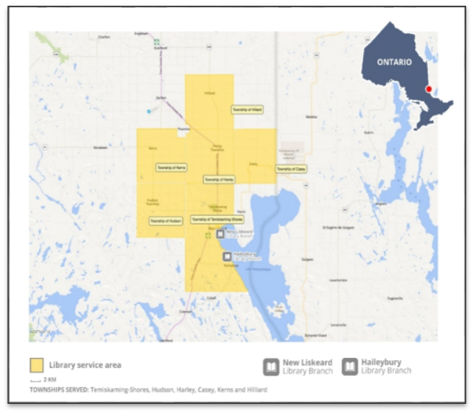
Contracting Township Partnerships
Contracts were established in 1990’s with the townships of Hudson, Harley, Casey and Kerns. The Township of Hilliard asked to contract in 2016.
Up until 2019 the townships contributed $12 per household to the TSPL budget.
A tax-paying household in Temiskaming Shores contributed $100.75 for library services in 2019.
The non-resident fee is $100 per year per household.
In the Fall of 2019 the TSPL Board asked for an increase in contribution to $25 dollar per household.
Three of the five townships, Casey, Kerns and Harley Townships, have all signed on for a two year contract.
Notes:
The library services contracts were established in 1990’s with the townships of Hudson, Harley, Casey and Kerns. The Township of Hilliard asked to contract in 2016.
From 1999 to 2019 the average household contribution requested of the townships was $12 per household. The townships simply matched the annual PLOG grant so the amount contributed per household was different for each township.
A tax-paying household in Temiskaming Shores contributed $100.75 for library services in 2019.
The non-resident fee for those living outside of Temiskaming Shores or a contracting township is $100 per year per household.
In the fall of 2019 representatives from the Library Board and City presented information about the library to each of the township councils, and asked for an increase in contribution to $25 dollar per household, with a $1 per year increase each year over a five year contract.
Three of the five townships, Casey, Kerns and Harley Townships, have all signed on for a two year contract.

Slide 16
A Visit Will Get You Thinking!

Slide 17
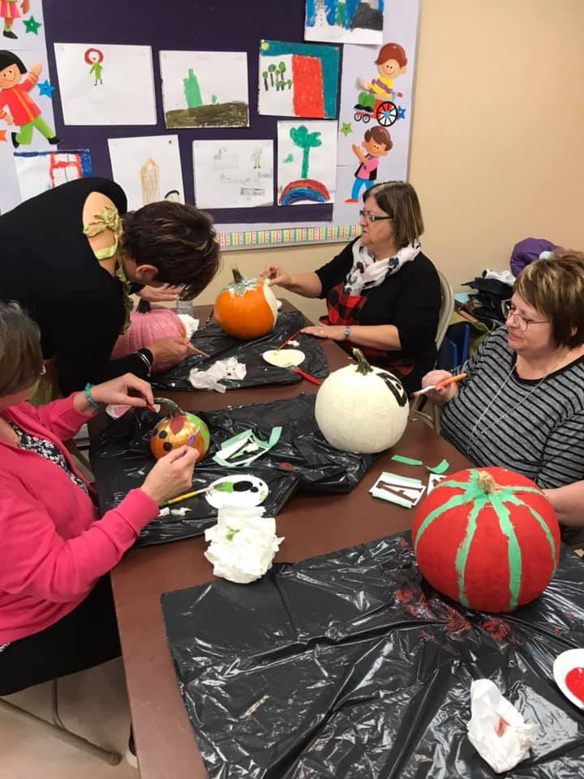
Programming: Why is it important?
fun literacy based activities
Provide social interaction
Influence materials that are checked out in your library
Help peak people’s interest in new activities
Great way to build community partnerships
Outreach to new users

Slide 18
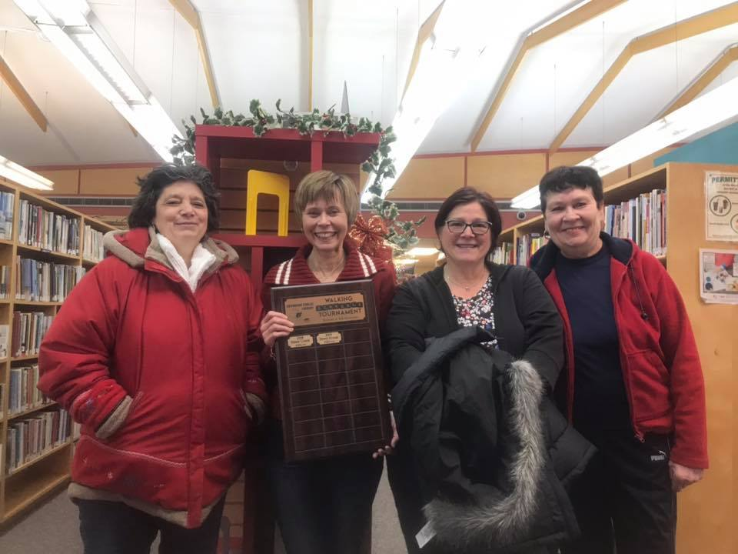
Walking Scrabble
A new literacy sport created in 2017
Involves walking a circuit and collecting letters
All ages can enjoy it!
Promotes literacy and physical activity

Slide 19
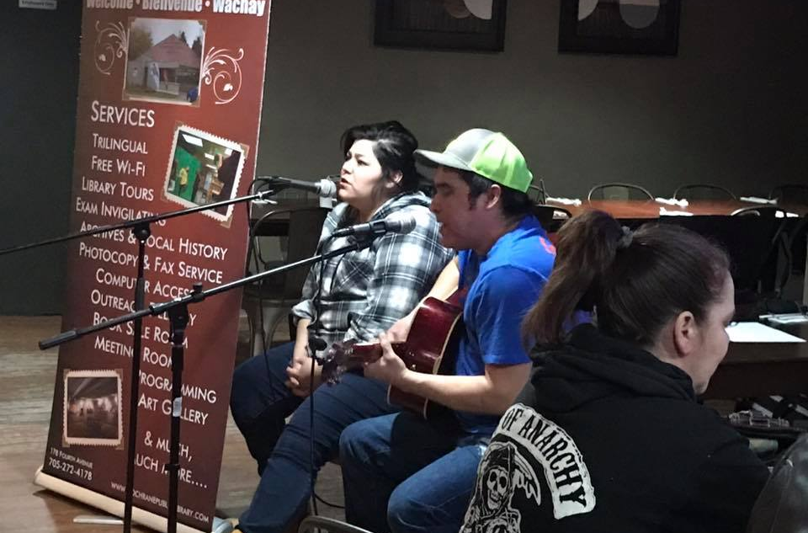
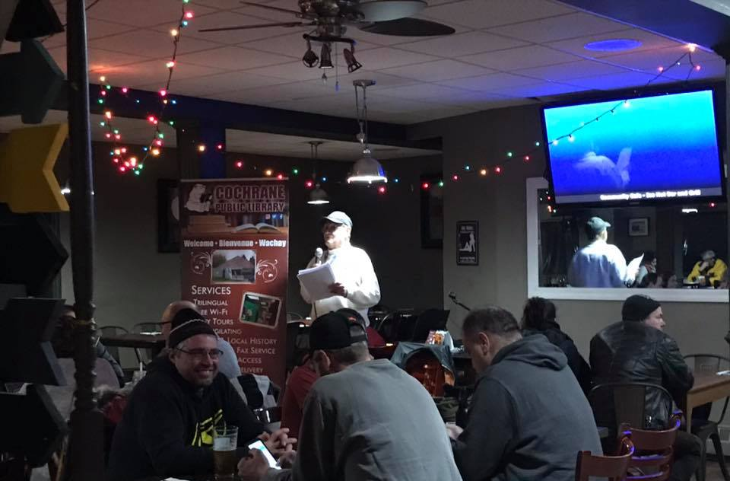
Community Café
Outreach opportunity
Reach many new people who haven’t gotten over the library stereotype
Promote literacy on many levels
All ages activity
Builds community partnerships
Monthly engagement with numbers growing

Slide 20
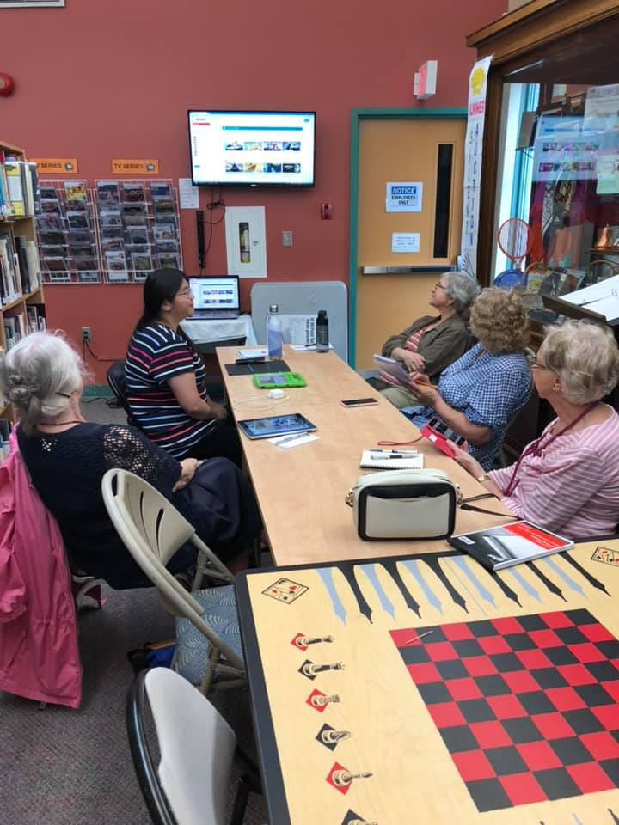
Tech Social
Teach the basics of technology
Great for seniors and adults alike
Can be facilitated by volunteers, co-op students
Builds confidence of the patrons
Allows you to promote online resources

Slide 21
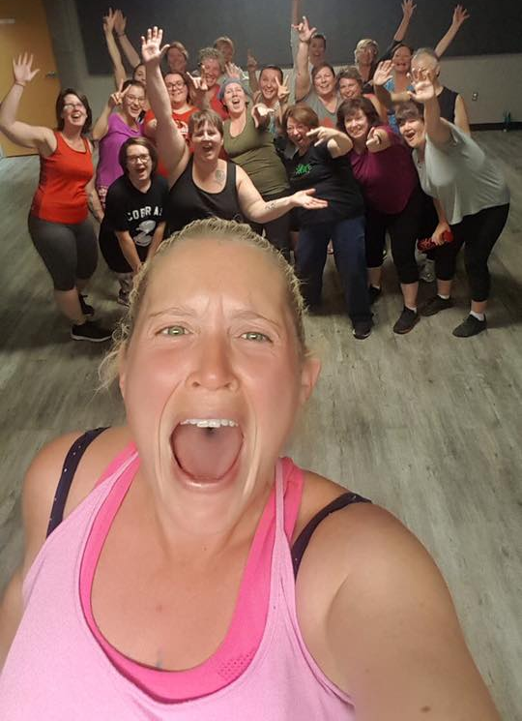
Skill Sharing
People are the biggest resource in your community
Allow them the opportunity to showcase their skills
Great experience for all involved
Easy way to host programming for libraries
Low budget – high impact
Creative and unique to the needs of your community
Partnership building

Slide 22
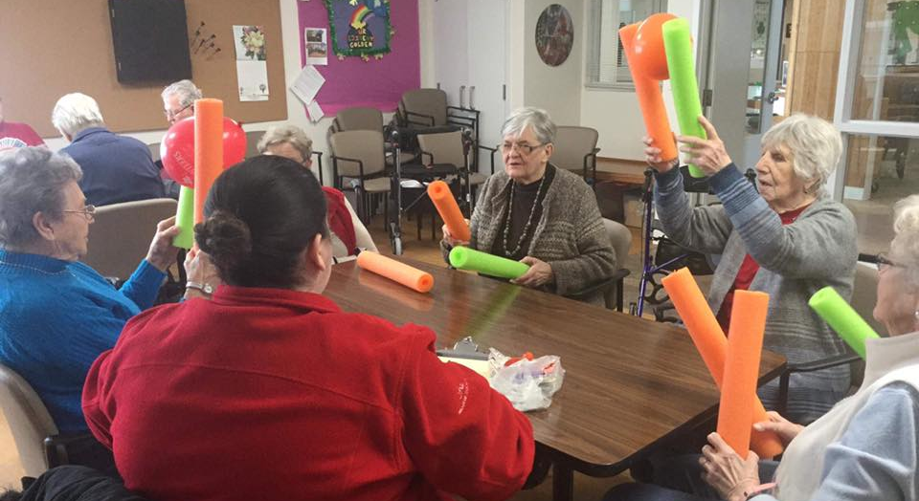
Programming Matters!
Big or small, programming has impact on your library
Many programs are already made for use
Customise things to suit your library needs
Don’t be afraid to get creative
Low tech is just as good as tech…. Sometimes better
Ardis Proulx-Chedore, Cochrane Public Library, ardis@cochraneontario.com

Slide 23
Small But Mighty
How Ontario’s Small Northern Libraries Contribute to the Provincial Library Landscape
Dayna DeBenedet | Dryden Public Library | DDeBenedet@dryden.ca
Rebecca Hunt | City of Temiskaming Shores Public Library | rhunt@temiskamingshores.ca
Ardis Proulx-Chedore | Cochrane Public Library | ardis@cochraneontario.com

